Slide 1
INT222
Git &GitHub

Slide 2
What is Version control?
Usecase
For such a big company there might be set of issues and challenges the company may face

Slide 3
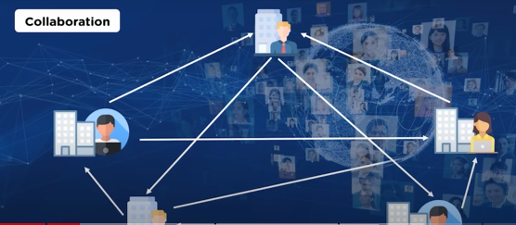
Collaboration

Slide 4
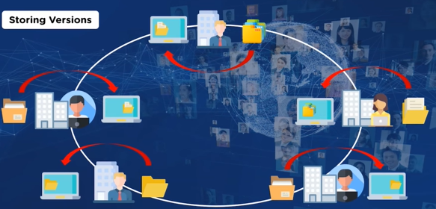
Storing versions

Slide 5
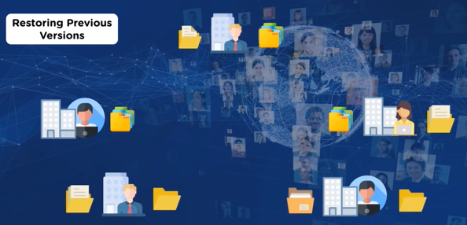
Restoring Previous versions

Slide 6
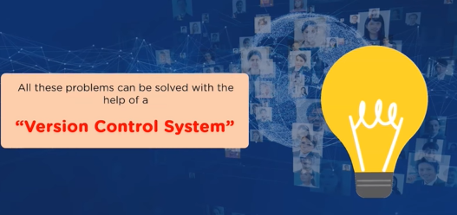
What could solve all these problems?

Slide 7
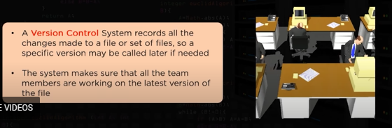
What is version control?

Slide 8
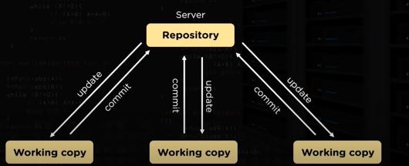
Version control

Slide 9
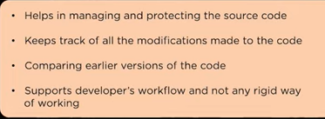
Benefits of version control

Slide 10
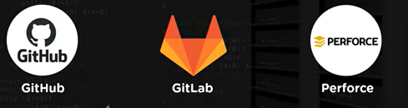
Best version control

Slide 11

Best Version control

